Slide 1

Chapter 4 Complexity Analysis
4.1 Computational and Asymptotic Complexity
The same problem can frequently be solved with different algorithms which differ in efficiency.
To compare the efficiency of algorithms, a measure of the degree of difficulty of an algorithm call computational complexity was developed.
Computational complexity indicates how much effort is needed to apply an algorithm or how costly it is.
Data Structures by R.S. Chang, Dept. CSIE, NDHU

Slide 2
Chapter 4 Complexity Analysis
4.1 Computational and Asymptotic Complexity
Time complexity: running time required (more important)
Space complexity: memories required
Time depends on:
the algorithm, the machine used, the programming language used, the compiler used, the environment, the programming skill, etc.

Slide 3


Chapter 4 Complexity Analysis
4.1 Computational and Asymptotic Complexity
To evaluate an algorithm’s efficiency, logical time units that express a relationship between the size n of an input and the amount of time t required to process the input should be used.
t=f(n)
Example:
:輸入資料量增加一倍，執行時間增加一倍
:輸入資料量增加一倍，執行時間增加一

Slide 4
Chapter 4 Complexity Analysis
4.1 Computational and Asymptotic Complexity
The resulting function gives only an approximate measure of efficiency. However, this approximation is sufficiently close, especially for a function which processes large quantities of data.
The measure of efficiency is called asymptotic complexity and is used when disregarding certain terms of a function to express the efficiency of an algorithm.(只留函數中最重要的部分)

Slide 5

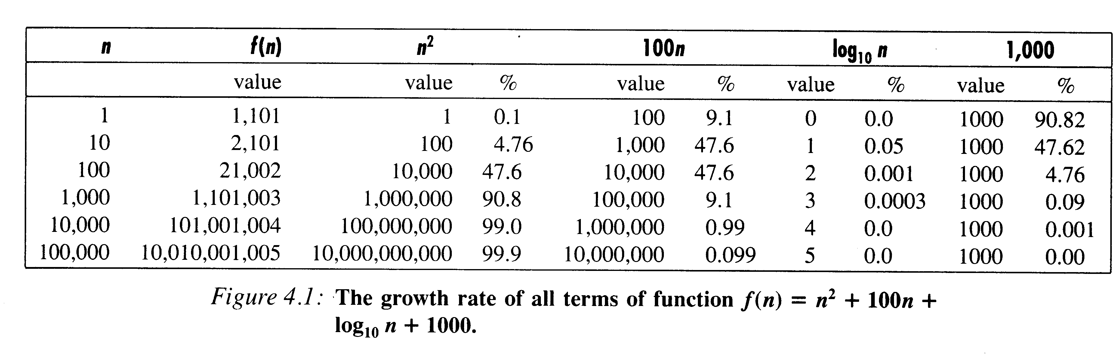
Chapter 4 Complexity Analysis
4.1 Computational and Asymptotic Complexity
Example:
Only the n² term is important when n becomes large.
Therefore, we say f(n)=O(n²)

Slide 6
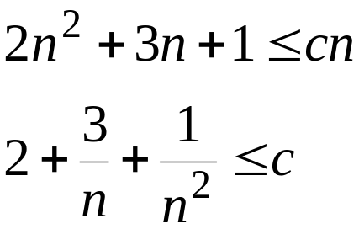

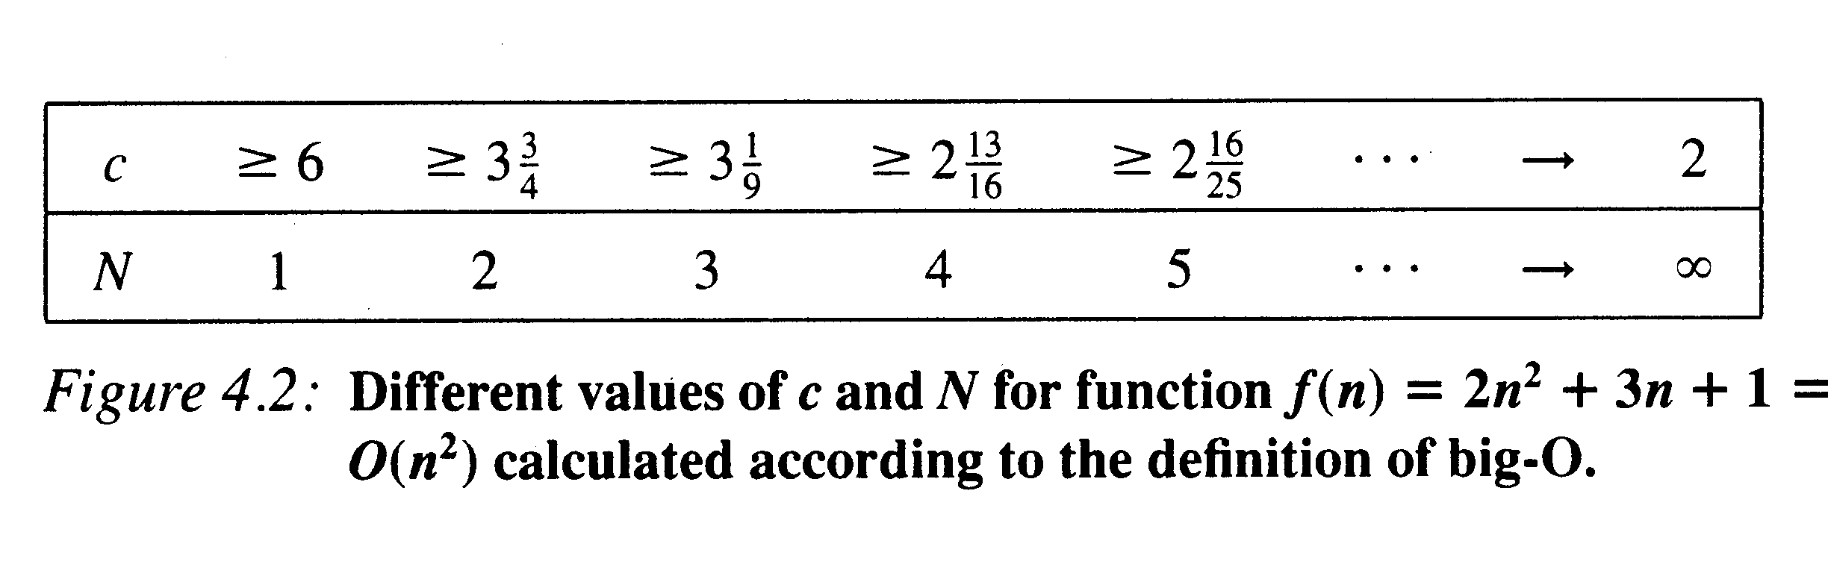
Chapter 4 Complexity Analysis
4.2 Big-O Notation
Definition: Given two positive-valued functions f and g, f(n) is O(g(n)) if there exist positive numbers c and N such that cg(n)≥f(n) for all n≥N.
Example:

Slide 7
Chapter 4 Complexity Analysis
4.2 Big-O Notation
Problem with the big-O notation:
It states only that there must exist certain c and N, but it does not give any hint how to calculate these constants.
There can be infinitely many functions g for a given function f. For example, f(n)=O(n²)=O(n³)=O(n⁴)=...
We want the lowest upper bound.

Slide 8
Chapter 4 Complexity Analysis
4.3 Properties of Big-O Notation
Fact 1. (transitivity) If f(n) is O(g(n)) and g(n) is O(h(n)), then f(n) is O(h(n)). (i.e., f(n)=O(g(n))=O(O(h(n)))=O(h(n)).
Fact 2. If f(n) is O(h(n)) and g(n) is O(h(n)) then f(n)+g(n) is O(h(n)).
Fact 3. The function of an^{k} is O(n^{k}).
Fact 4. The function n^{k} is O(n^{k+j}) for any positive j.
Fact 5. If f(n)=cg(n) then f(n)=O(g(n)).
Fact 6. log_{a}n=O(log_{b}n) for any numbers a and b greater than 1.
Fact 7. log_{a}n is O(log₂n) for any positive a.

Slide 9
Chapter 4 Complexity Analysis
4.4 Ω (omega) and Θ (theta) Notations
Definition 2. The function f is Ω(g(n)) if there exist positive numbers c and N such that f(n)≥cg(n) for all n≥N.
We want the greatest lower bound.
f(n) is Ω(g(n)) iff (if and only if) g(n) is O(f(n)).

Slide 10
Chapter 4 Complexity Analysis
4.4 Ω (omega) and Θ (theta) Notations
Definition 3. f(n) is Θ(g(n)) if there exist positive numbers c₁, c₂, and N such that c₂g(n)≥f(n)≥c₁g(n) for all n≥N.
f(n) is Θ(g(n)) iff f(n) is O(g(n)) and f(n) is Ω(g(n)).

Slide 11
Chapter 4 Complexity Analysis
4.5 Possible Problems
Big-O notation is the asymptotic complexity function. Please don’t forget there are concealed constants.
For example: 10⁸n is O(n) and 10n² is O(n²). However, for 10⁷≥n, 10n² is better.

Slide 12
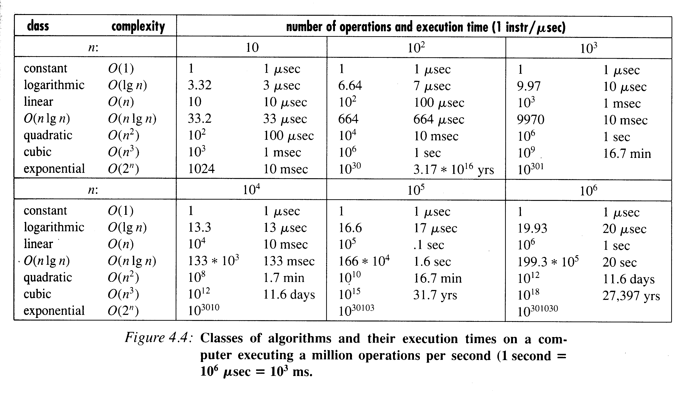
Chapter 4 Complexity Analysis
4.6 Examples of Complexities

Slide 13
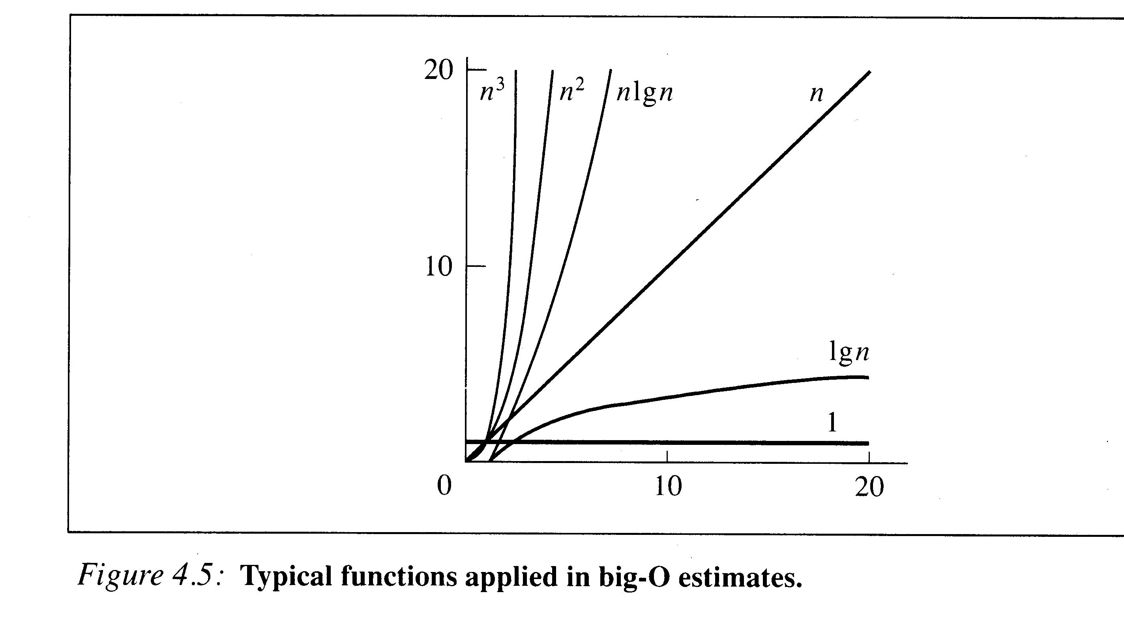
Chapter 4 Complexity Analysis
4.6 Examples of Complexities

Slide 14

Chapter 4 Complexity Analysis
4.7 Finding Asymptotic Complexity: Examples
Example 1:
for (i=sum=0; i<n; i++) sum += a[i];
O(n)
Example 2:
for (i=0; i<n; i++) {
for (j=1 sum=a[0]; j<=i; j++)
sum += a[j];
printf(“sum for subarray 0 through %d is %d\n”,i,sum);
}

Slide 15
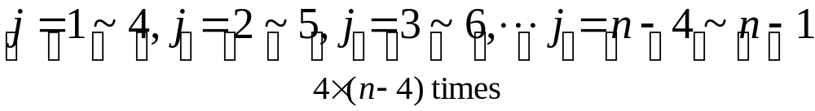
Chapter 4 Complexity Analysis
4.7 Finding Asymptotic Complexity: Examples
Example 3:
for (i=4; i<n; i++) {
for (j=i-3, sum=a[i-4]; j<=i; j++)
sum += a[j];
printf(“sum for subarray %d through %d is %d\n”,i-4,i,sum);
}
O(n): 課本的計算式有誤

Slide 16
Chapter 4 Complexity Analysis
4.7 Finding Asymptotic Complexity: Examples
Example 4: Determine the longest increasing subarray.
For (I=0, length=1; I<n-1; I++) {
for (i1=i2=k=I; k<n-1 && a[k]<a[k+1]; k++,i2++);
if (length <i2-i1+1) length=i2-i1+1;
}
Worst case: O(n²)
Best case: O(n)
Average case: ???

Slide 17
Chapter 4 Complexity Analysis
Exercise: 2 and 5 in Page 56.

